Slide 1
Joint Resolution (Act 95): Summary of Process and Recommendations
Presented to a Joint Session of the South Carolina Senate Finance Committee and House Ways and Means Committee
February 13, 2020

Slide 2
Santee Cooper Project Advisors
Gibson, Dunn & Crutcher LLP – Legal Advisor
Gerald “Jerry” Farano
Melissa Persons
Moelis & Company – Lead Financial Advisor
John Colella
Nathan Barnes
Energy and Environmental Economics, Inc. (E3) – Market Advisor
Nathan “Nate” Miller

Slide 3
Agenda
Overview of Process
Evaluating Rate Projections
Santee Cooper Reform Plan
Management Proposal – Dominion Energy
Bid for Sale – NextEra Energy
Potential Benefits and Additional Considerations
Conclusion

Slide 4
Overview of Process

Slide 5
Key Considerations
Pursuant to Act 95, the Department hired advisors in June and July, 2019
The Department and advisors immediately began to prepare the necessary process materials and data room and publicly announced an invitation for interested parties on Aug. 16, 2019
Process and timeline were developed with a view to facilitate negotiations with Central while also maximizing outcomes as defined by Act 95

Slide 6
Key Process Items
26,000+ of Data Room documents
358,000+ of Data Room pages
2,000+ diligence questions
Approximately 50,000+ man-hours
Hundreds of conference calls and in-person meetings

Slide 7
Overview of Participants
Parties Contacted | 55
NDAs Executed | 13
Data Room Access Granted | 13
 | SALE | MANAGEMENT CONTRACT
Management Presentations | 5 (2 Consortiums) | 3 (1 Consortium)
Site Visits | 3 (2 Consortiums) | 2 (1 Consortium)
Final Proposals Submitted | 2 (1 Consortium) | 2

Slide 8
Timeline
5/22: Joint Resolution passed
10/14: Process Letter with specific guidance on JR requirements and fixed / supported assumptions provided to participants
1/3: Deadline for Revised Submissions
6/11: RFPs issued
11/26: Deadline for Submissions
2/11: Submission of Report
9/20: Data Room Access provided to Participants
10/4 – 10/18: Management Presentations
APA / Management Contract Negotiations with Admin and 3 participants
10/3: Confidential Information Presentation uploaded to Data Room
Finalization of Marketing Materials with multiple SC meetings
12/3: Participant negotiations with Central on PPA; 5 in-person Central meetings with 4 participants
8/16: Process launch
6/25, 7/18, 7/26: Advisors notified of selection
10/29 – 11/15: Participant Site Visits
2/4: Deadline for Final Submissions with supporting documentation / contracts

Slide 9
Detailed Timeline
2019
5/21 – 5/22
The General Assembly and Governor of South Carolina passed Joint Resolution (A95, R113, H4287)
2019
6/11
The Department issued RFPs for (1) M&A Advisory, (2) Legal Advisory, and (3) Energy Consulting
2019
6/25, 7/18, 7/26
Moelis, Gibson Dunn and E3 were notified of selection from RFP Process
2019
8/16
Department posted Invitation to Participate; Moelis reached out to potential participants to gauge interest in the Bidding Process
2019
9/20
Access to Data Room was provided to each Participant that had executed an NDA
2019
10/3
Final Version of Management Presentation / Confidential Information Packet uploaded to Data Room
2019
10/4 – 10/18
Meetings with Santee Cooper management and Participants
2019
10/14
The Department and Santee Cooper entered in a Confidentiality Agreement
2019
10/14
Process Letter uploaded to the Data Room
2019
10/14
The Department made available a Draft Power Purchase Agreement for Participants and Central
2019
10/26
The Department made available a Draft Asset Purchase Agreement for Participants

Slide 10
Detailed Timeline
2019
10/29 – 11/15
Participant Site Visits
2019
11/18
Central entered into Confidentiality Agreement with Department
2019
11/26
Deadline for Submission of the Reform Plan, Management Proposals, and the Sale Bids
2019
12/3 - 12/6
Participants and Central meet to negotiate Power Purchase Agreement
2019
12/10 – 12/12
The Departments meets with Participants to provide feedback on their proposals
2019
12/11 – 1/2
The Department supervises meetings, calls and email exchanges between Participants and Central
2020
1/3
Deadline for submission of the revised proposals by Participants
2020
1/15 – 1/16
The Departments meets with Participants to provide feedback on their proposals
2020
1/15 – 2 / 4
The Department supervises meetings, calls and email exchanges between Participants and Central
2020
2/4
Deadline for submission of any / all changes to proposals from Participants
2020
2/11
Report Submission

Slide 11
Process Considerations
Process was delayed by months by a lack of cooperation by Santee Cooper
Delay in funding the Department in June delayed the Process by nearly a month
The Data Room for participants was delayed in opening based on Santee Cooper failing to provide data in an efficient or expeditious manner
Threatened to not conduct management presentation due to not having a signed NDA with Admin (including when participants were in Santee Cooper’s building for the Management Presentation)
Entering into Southern MOU had a chilling effect on multiple bidders and had unknown negative impacts
Santee Cooper rank and file employees continue to be a bright spot for Santee Cooper, and they worked tirelessly to support the Process

Slide 12
Evaluating Rate Projections

Slide 13
Evaluating Rate Projections
Customer rates are critically important in considering options for Santee Cooper’s future…
…as recognized by the JR requirement for “electrical rate projections and projected financial impact to Santee Cooper retail customers”
Electricity Rates depend on many factors:
Fuel
Operations, Maintenance, and Overhead
Recovery of Capital Investment
Taxes (Federal, State, Local)
Revenue Requirement
Rate projections need to be “normalized”…
To ensure a fair comparison of proposals
To provide a sound basis for the General Assembly’s decision-making based on facts and a greater likelihood of achievement
Notes:
Participants have a strong incentive to use assumptions that favor their own bid: low fuel prices, low interest rates, high efficiencies, high cost savings
All bidders face the same world; the same external factors
Bids must be standardized to ensure that what you see is actually what you get—this protects ratepayers, taxpayers, and bondholders as required by the JR

Slide 14
“Apples to Apples” Comparisons
Standardized assumptions → proposals are differentiated ONLY by plans, commitments and competitive advantages.
Participants each submitted the Revenue Requirement Model
Submissions normalized by three kinds of assumptions, as specified in the Process Letter:
Bidder A
Bidder B
Fixed Assumptions
Same external factors for all Participants
Gas prices, interest rates, inflation, load forecasts…
Same
Same
Supported Assumptions
Justification required for different value
Resource costs, operational efficiencies, other cost savings…
Justified
NOT Justified
Variable Assumptions
Participants provide their own values
Resource plan, fees/purchase price, financing structure, return on equity…
Unique
Unique
Notes:
Fixed Assumptions: all Participants required to use the same values
Supported Assumptions: all Participants use standard values, unless they propose an alternative and justify why they are able to deliver on it (a plan, a contractual commitment, or a competitive advantage)
Variable Assumptions: unique to each Participant; core part of bid economics

Slide 15
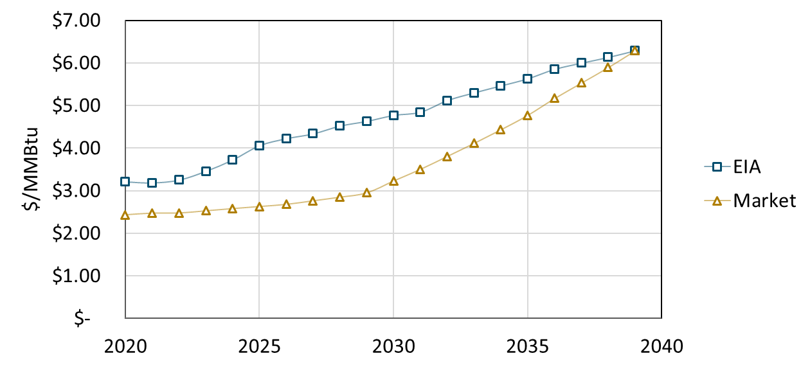
Natural Gas Price Forecasts
Future gas prices were the largest factor impacting rate projections
Each Participant proposed to increase gas-fired generation to save on costs compared to coal, and each had a distinct view of future gas prices
The Professional Service Experts used two book-end, well-supported projections to forecast each Participant’s plan
Henry Hub Gas Price Forecast used in the Process
Notes:
Commodity price of natural gas forecasted at Henry Hub (Louisiana Gulf Coast delivery location, used nationally and globally as a price point for U.S. natural gas supplies)
EIA mid scenario: long-term, fundamentals-based supply and demand forecast
Market scenario:
First 10 years: NYMEX forward price curve
World’s 3rd largest physical commodity futures; used in U.S., South America, Asia, Europe
Deep, liquid trading market (400,000 contracts traded daily)
Last 10 years: linear transition to EIA mid price in 2039
Both scenarios: delivered gas price = commodity gas price + transport fees (TransCo zone 5 >> delivery to Rainey and Summer sites)

Slide 16
Santee Cooper Reform Plan

Slide 17
Key Terms of Santee Cooper Reform Plan
Santee Cooper would implement a new power supply roadmap (↑ reliability, ↓ coal/emissions, ↓ cost)
Santee Cooper would reduce its outstanding debt by $4.7 Billion over 20 years
New transparency and oversight measures would improve governance and increase stakeholder involvement
Reform is dependent on legislative action and Santee Cooper’s ability to successfully implement the plan
The Reform Plan does not resolve the Cook litigation; the Reform Plan does not expressly propose how to repair the Central relationship
Santee Cooper would reduce headcount by 10% without any layoffs (retraining, attrition, and retirement only)

Slide 18
Financial Overview of Santee Cooper Reform Plan
Current credit rating – A2/A-
Outstanding debt – $6.9 Billion
Reform plan pays down $4.7 Billion in debt over 20 years
All liabilities remain outstanding
Estimated $2.3 Billion NPV improvement to customer rates relative to 2019 budget

Slide 19
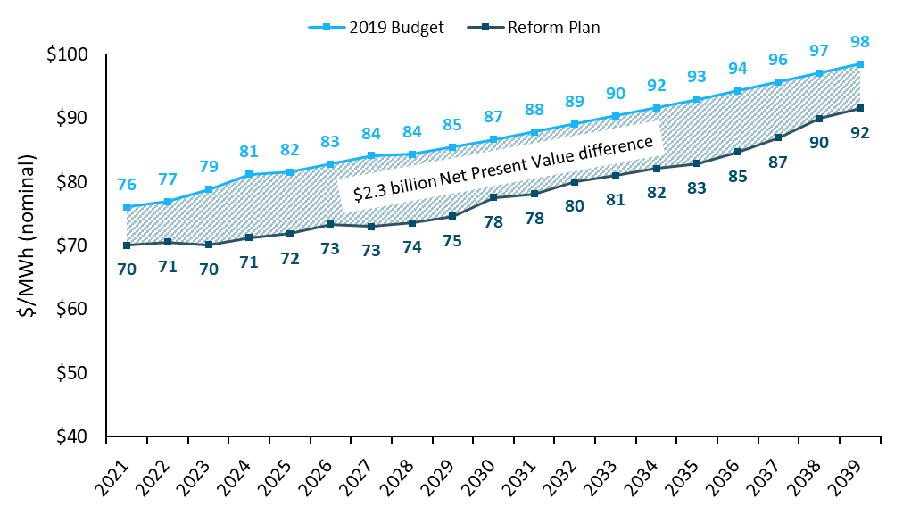
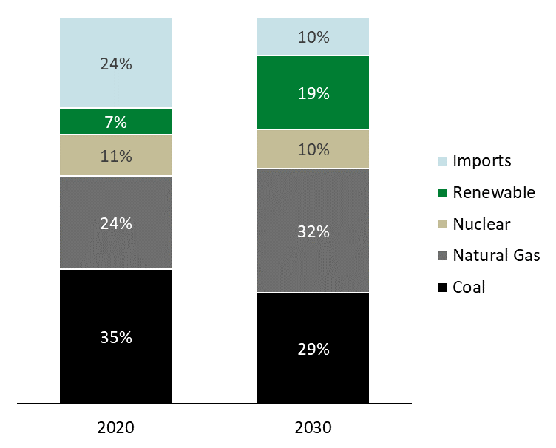
Projected Santee Cooper Rates Under Reform Plan
Santee Cooper Reform Plan savings achieved through
+Retirement of coal-fired Winyah Generating Station
+New natural gas, solar, and battery storage additions
+Debt refinancing and paydown

Slide 20
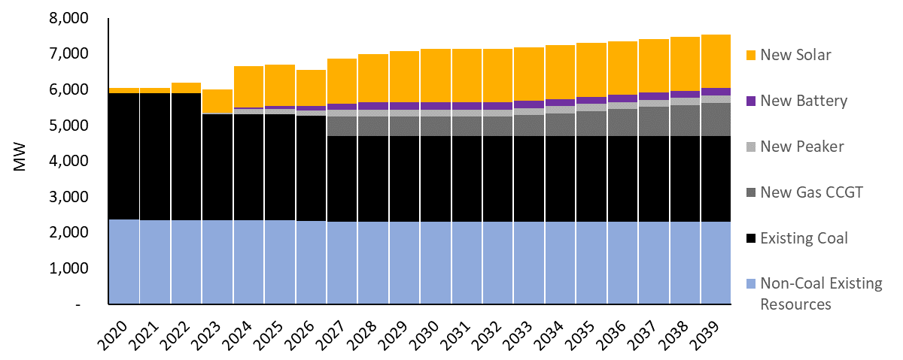
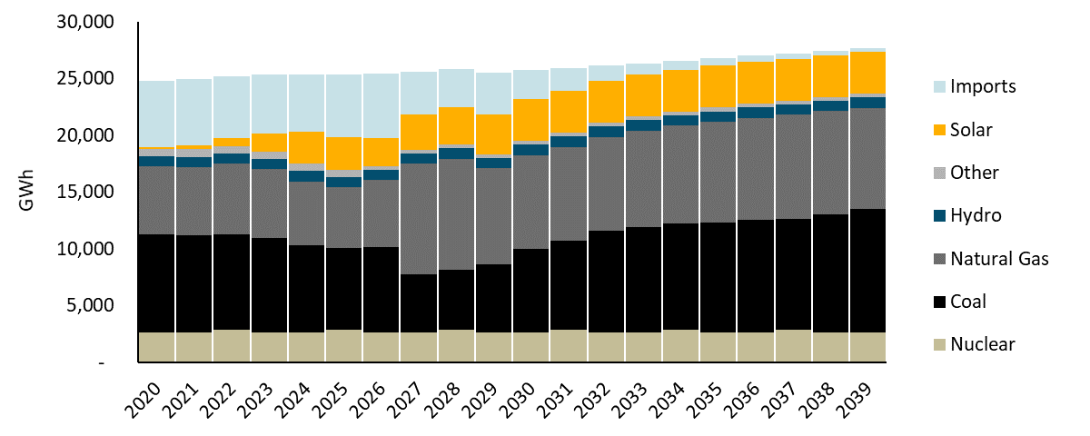
Proposed Santee Cooper Generation Mix
Santee Cooper modernizes generation mix through:
Retirement of the Winyah coal station
New additions of natural gas, solar, and battery storage
Installed Capacity (MW)
Energy Mix (GWh)
+ 200 MW (2-hr batteries)
Total Additions: 2,449 MW
+ 549 MW (CCGT)
+ 50 MW (peaker @ Winyah)
+ 1,000 MW (Solar PPAs)
+ 150 MW (peakers @ Winyah)
+ 40-390 MW (Contracted capacity with existing CCGTs in the region)
+ 500 MW (Solar PPAs)
2020
2022
2024
2027
2030
2033
2036
2039
- 580 MW (Winyah 3+4)
- 570 MW (Winyah 1+2)
Total Retirements: 1,150 MW

Slide 21
Management Proposal — Dominion Energy

Slide 22
Key Terms of Dominion Management Proposal
Dominion would place three of its executives as senior managers at Santee Cooper (and would consider placing one as CEO)
Dominion would not charge a management fee; it would only be reimbursed for its costs
Dominion would seek mutual cost savings through synergies with Santee Cooper
Term: 10 years, with an option to terminate upon a change of control of either party
Dominion executive to be Santee Cooper’s primary point of contact for Central
Benefits may not be realized without additional legislative reform at Santee Cooper

Slide 23
Financial Overview of Dominion Management Proposal
Current market capitalization of approximately $70 Billion, representing one of the largest publicly traded utilities globally
Credit Ratings
HoldCo: BBB+/Baa2
Assumes Reform Plan implemented as proposed by Santee Cooper
Proposed incremental joint cost savings to benefit Santee Cooper customers
Operating synergies and partnerships
Only recovery of placed employee costs; no other management fees
No payment to the State beyond Santee Cooper’s current practices

Slide 24
Bid for Sale — NextEra Energy

Slide 25
Key Terms of NextEra Bid for Sale
Defeases 100% of debt at closing and covers all defeasance costs
Provides payment to State and allows the State to keep Santee Cooper balance sheet cash to cover estimated liabilities left behind
Offers solution to Cook litigation and additional credits for ratepayers
Sources of Funds | $ millions | SCP&L Capitalization | $ millions | Uses of Funds | $ millions
NextEra Cash Contribution | 5,410.3 | SCP&L Equity | 2,929.5 | Santee Cooper Bonds Outstanding | 6,553.1
Corporate Bonds | 2,720.5 | SCP&L Debt | 2,720.5 | Santee Cooper Commercial Paper | 306.2
Securitization Bonds | 1,330.8 | SCP&L Rate Base | 5,650.0 | Debt Defeasance Penalties | 1,046.2
 |  |  |  | Payment to State | 500.0
 |  |  |  | Funding of Escrow | 100.0
 |  |  |  | Reimbursement of Transaction Costs | 15.0
 |  |  |  | Customer Refunds & Credits | 941.0
 |  |  |  | for Cook litigation | 541.0
 |  |  |  | for all ratepayers | 400.0
TOTAL | 9,461.5 |  | 5,650.0 |  | 9,461.5
25
Notes:
Santee Cooper Bonds Outstanding + Commercial Paper @ 12/31/19
NextEra contractually commits to paying full defeasance penalties and outstanding debt up to the 12/31/19 balance
Proceeds to the State:
$500 million at closing
+ $500 million cash on Santee Cooper’s balance sheet
+ anything left in escrow account after claims are made
Customer refunds / credits:
$541 million refund for Cook Litigation, paid within 180 days or applied as credit to customer bills
$400 million rate credits applied to all customers during fixed rate period (first four years)

Slide 26
Key Terms of NextEra Bid for Sale
CONSIDERATION |  |  | CERTAIN KNOWN REMAINING LIABILITIES
Cash Consideration |  |  | Employee Benefits
Cash | $500mm |  | Pension | $309.7mm
Cash (post-closing escrow) | $100mm |  | OPEB | $186.7mm
Cash (expense reimbursement) | $15mm |  | SERP | $13.6mm
 | TOTAL $615mm |  | Accrued vacation | $14.4mm
 |  |  |  | TOTAL $525mm
Debt Repayment and Defeasance
Defease/repay long-term and short-term debt | $6.859B
Defeasance and make-whole costs | $1.05B
 | TOTAL $7.909B
Customer Rate Credits
To settle Cook litigation | $541mm
To current wholesale and resale customers | $400mm
 | TOTAL $941mm
TOTAL CONSIDERATION $9.4615B
CASH ON BALANCE SHEET**
Non-nuclear cash on SC balance sheet to be retained by Santee Cooper/State | $485mm to 535mm

Slide 27
Financial Overview of NextEra Bid for Sale
Current market capitalization of approximately $130 Billion, largest publicly traded utility globally
Credit ratings
HoldCo: A-/Baa1
Approximately $1.1 Billion proceeds to the State to offset liabilities left behind
$600 Million payment to the State, $100 Million to be held in escrow
Approximately $500 Million of balance sheet cash to be provided to the State
$15 Million in transaction reimbursement to the State
Substantially all pre-closing liabilities to be left behind with the State

Slide 28
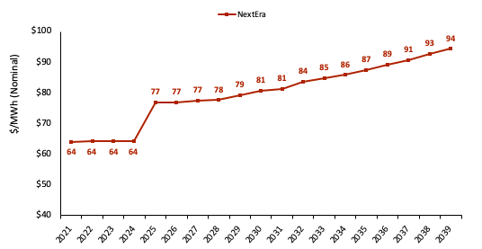
Projected NextEra Rates Under Bid for Sale

Slide 29
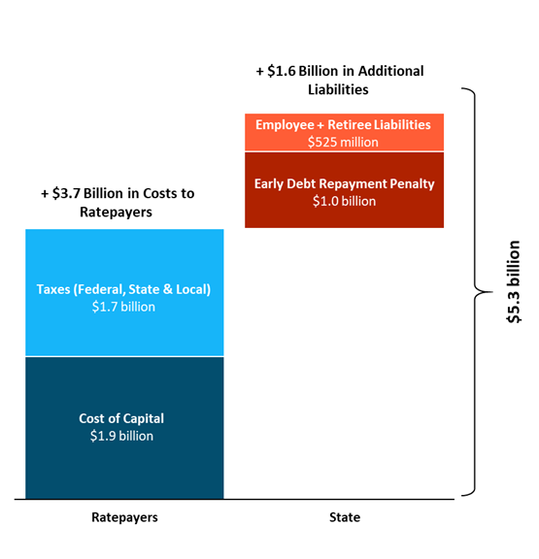
Any Bid for Sale Faces Structural Hurdles
Sale Bidders face a “hill” of additional costs to ratepayers and the State.
Structural differences between publicly-owned utilities and investor-owned utilities create ~$3.7 billion in costs.
Liabilities triggered by the sale amount to $1.6 billion in costs to be settled at closing.
Overcoming the hill is critical to delivering value in a sale…
29

Slide 30
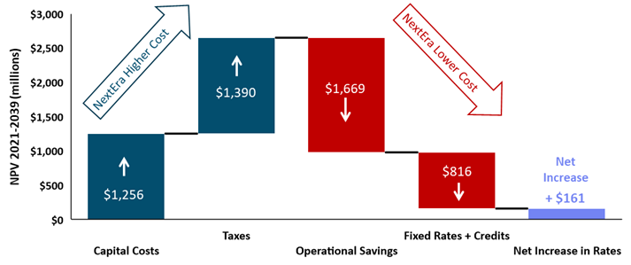
NextEra Bid for Sale Addresses Structural Hurdles
NextEra Bid for Sale successfully climbs the “hill” of an IOU transition…
Limited increase in projected rates vs. Santee Cooper Reform Plan
Provides funds to cover additional liabilities to the State
30
Notes:
NextEra savings:
Fuel savings: large CCGT replaces coal with low-cost gas, like Santee, low-cost solar also saves fuel
O&M savings: Winyah and Cross, T&D networks
G&A savings: outsource many HQ functions to Juno Beach; benefit from efficiencies in combined systems (HR, procurement, etc.)

Slide 31
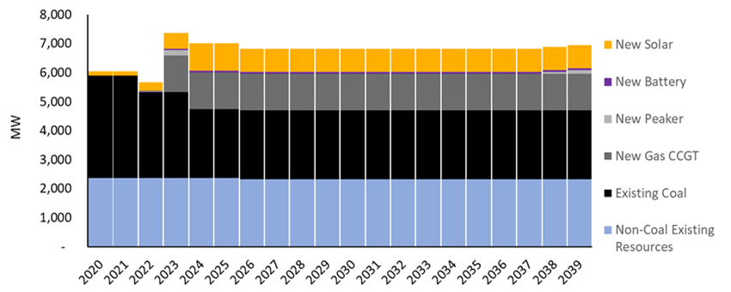
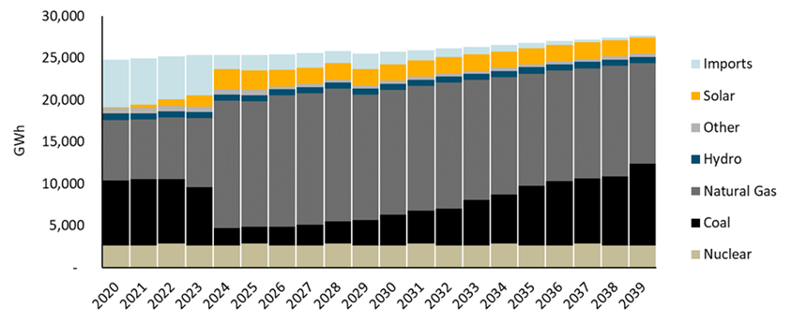
NextEra Bid for Sale Generation Mix
NextEra modernizes generation mix through:
Accelerated retirement of the Winyah coal station
Early, large addition of CCGT in Fairfield County, plus solar and battery storage additions
Installed Capacity (MW)
Energy Mix (GWh)
+ 1,250 MW (CCGT)
+ 800 MW (Solar)
+ 50 MW (4-hr Batteries)
+ 300 MW (Rainey upgrade)
Total Additions: 2,400 MW
2020
2022
2024
2027
2030
2033
2036
2039
- 151 MW (SEPA)
- 570 MW (Winyah 1+2)
Total Retirements: 1,301 MW
- 580 MW (Winyah 3+4)
31

Slide 32
Potential Benefits and Additional Considerations

Slide 33
Santee Cooper Reform Plan
Potential Benefits
Additional Considerations
Low Cost
Lowest cost alternative and $2.3 billion lower than previous plan
Generation Modernization
Retirement of coal and new natural gas, solar, and battery storage
Governance Improvements
More oversight and stakeholder engagement
Central Improvements
Concession on several key terms in contract
No Layoffs
Staff reductions accomplished through retirement and retraining
Debt Payoff
Pays down $4.7 billion by 2039
State Control
Control of utility stays within South Carolina
Safety and Reliability
Santee likely to continue excellent track record
Central Relationship
Relationship remains strained due to historical friction and fundamental disagreements
Governance Changes
Proposed changes could go further for more oversight on pricing and planning
Necessary Codification
Without legislative codification of Reform Plan, progress created by JR could be lost
Track Record
Santee Cooper does not have a track record of generation modernization as contemplated in Reform Plan
Litigation
Does not resolve Cook litigation
33

Slide 34
Dominion Management Proposal
Potential Benefits
Additional Considerations
No Management Fee
Santee Cooper only reimburses costs of Dominion employees placed at Santee Cooper
Limited Duration
Management contracts lasts 10 years with option to extend
Track Record
Dominion is a large and well-respected investor owned utility
Central
Central has expressed positive view in dealing with Dominion
Synergies
Possible synergistic efficiencies and savings with Dominion
Debt
Debt remains outstanding
Litigation
Does not resolve Cook litigation
Implementation
Dominion managers still subject to oversight from Santee Cooper CEO and Board
Reform Plan
Benefits of proposal may not be realized without Santee Cooper reform
Conflict of Interest
Potential for Dominion managers to pursue synergistic savings with Dominion ahead of internal Santee savings
Savings
The proposed synergistic savings are difficult to quantify
34

Slide 35
NextEra Bid for Sale
Potential Benefits
Additional Considerations
Debt Defeasance
Immediately pays off all debt, including early repayment penalties
Litigation
Provides roadmap and resources to resolve Cook litigation through $541 million ratepayer credit and the payment of plaintiffs’ lawyers’ fees
Rate Credits
Provides additional $400 million to ratepayers upfront
Payments to State
Provides $515+ million to State
Approximately $500 million of balance sheet cash goes to the State
Synergistic Savings
Opportunity for meaningful savings by combining operations with other NextEra utilities such as FPL
Generation Modernization
Retires coal and replaces it with a combination of new natural gas, solar, and battery storage
Track Record
NextEra is a large and well-respected investor owned utility
Legislative Ask
Comprehensive legislation bypasses traditional Public Service Commission oversight and opportunity for public stakeholder engagement by pre-approving:
Rates for four years
$2.3 billion in new generation capital expenditures
Fee-in-lieu of taxes provisions
Securitization bonds
Non-standard depreciation with opportunity to defer costs after the four-year fixed rate period
Headcount Reduction
Immediately lays off 300 employees and ultimately reduces 660 employees below Reform Plan by 2025
Out-of-State Reporting
Management will be based in Moncks Corner but will report to NextEra leadership in Juno Beach, FL
Liabilities
Most pre-closing liabilities will remain behind
35

Slide 36
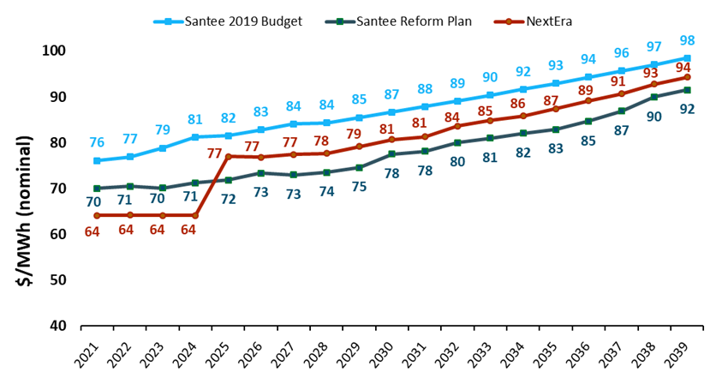
Results
Santee Reform Plan saves $2.3 billion (NPV) vs. Santee 2019 Budget
NextEra Sale Proposal defeases 100% of Santee Debt, covers additional liabilities; projected rates are 10% lower than Santee for four years, then 5% higher
36

Slide 37
Conclusion

